Slide 1



Linux and Git Fundamentals: Understanding the Core of Development
An Introduction to Linux Internals & Git
Saranya Gopal Charulatha V
Lead SW Engineer SW Engg Manager
er
Intel Technology India Pvt Ltd

Slide 2
What is Linux?
Linux is an open-source, Unix-like operating system kernel.
- Created by Linus Torvalds in 1991
- Used in servers, mobile devices (Android), and embedded systems
- Highly secure, customizable, and supports multi-user environments

Slide 3
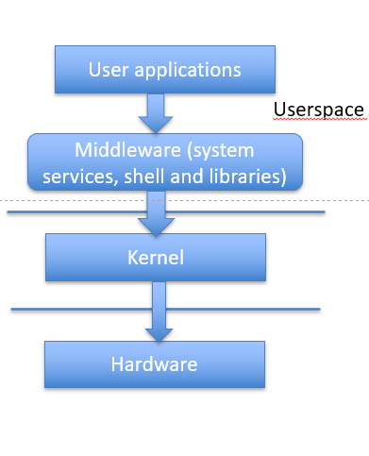
Linux Architecture
Four Main Layers:
1. Hardware - Physical components (CPU, RAM, Disk, etc.)
2. Kernel - Core part managing hardware resources
3. Middleware - System services and libraries that can be used by apps
4. User Applications - Programs running on Linux (Browsers, IDEs, etc.)

Slide 4

Kernel Components
Key Features of the Linux Kernel:
Process Management - Handles running programs
Memory Management - Allocates RAM efficiently
File Systems - Manages data storage and retrieval
Device Drivers - Interfaces with hardware like USB, GPU, etc.

Slide 5
Kernel subsystems
Core/central
arch-specific initialization
memory management
file system
timers & scheduling
drivers/base
power
Peripheral
Video: V4L2
Gfx: drm
Input
Sound: ALSA
Network
USB
MMC/SD
RTC, WDT

Slide 6
Driver interfaces
Interface with applications
file operations (open/read/write/ioctl)
Sysfs
Procfs
netlink socket
Interface with hardware
Registers
Memory
Interrupts
Peripherals like DMA, PRCM, etc.
Interface with kernel
registering driver, device
Kernel services: Locking, timers, threads, scheduling, deferring etc.
exporting functions

Slide 7
Write a simple driver (homework ☺)
Put a LDM skeleton
Struct for the driver
For each hardware peripheral that can use this driver, create an instance of the device structure
Add driver init() and exit() functions – called when the module is loaded
Register the driver with the kernel:
driver_register()
Register to the driver class
Basic - char driver, block driver or network driver?
Or register to subsystem?
Create file operation functions, and structure (f_ops)
Register the driver with the file_operations
Register the devices:
device_register() … for all devices
Add functionality f_ops and register/unregister to “class” / subsystem
Add probe(), remove(), suspend(), resume() functions
These functions are called once per device
Examples widely available in net. Here’s one such example: https://www.geeksforgeeks.org/linux-kernel-module-programming-hello-world-program/

Slide 8
Hello world driver
#include <linux/module.h> /* Needed by all modules */
#include <linux/kernel.h> /* Needed for KERN_INFO */
#include <linux/init.h> /* Needed for the macros */
///< The license type -- this affects runtime behavior
MODULE_LICENSE("GPL");
///< The author -- visible when you use modinfo
MODULE_AUTHOR(“Saranya Gopal");
///< The description -- see modinfo
MODULE_DESCRIPTION("Hello world!");
///< The version of the module
MODULE_VERSION("0.1");
static int __init hello_start(void)
{
printk(KERN_INFO "Loading hello module...\n");
printk(KERN_INFO "Hello world\n");
return 0;
}
static void __exit hello_end(void)
{
printk(KERN_INFO "Goodbye\n");
}
module_init(hello_start);
module_exit(hello_end);

Slide 9
Building the driver
Install the tools required to build kernel:
$sudo apt-get install build-essential linux-headers-$(uname –r)
Create a file called Makefile and add the below content:
obj-m = hello.o
all:
make -C /lib/modules/$(shell uname -r)/build/ M=$(PWD) modules
clean:
make -C /lib/modules/$(shell uname -r)/build M=$(PWD) clean
Build the driver:
$make
make -C /lib/modules/6.8.0-31-generic/build/ M=/home/saranya/Documents/hello-module modules
make[1]: Entering directory `/usr/src/linux-headers-6.8.0-31-generic'
CC [M] /home/saranya/Documents/hello-module/hello.o
Building modules, stage 2.
MODPOST 1 modules
CC /home/saranya/Documents/hello-module/hello.mod.o
LD [M] /home/saranya/Documents/hello-module/hello.ko
make[1]: Leaving directory `/usr/src/linux-headers-6.8.0-31-generic'
Load the driver:
$sudo insmod hello.ko
Kernel logs (sudo dmesg) will show the “Hello world” and “Goodbye” messages which we had added in the driver.

Slide 10
Build the whole kernel (for Ubuntu)
Clone the Linux git repo:
$git clone https://github.com/torvalds/linux.git
Navigate to linux directory:
$cd linux
Make the kernel config:
$make olddefconfig
Build the kernel:
$make bindeb-pkg –j`nproc
It will create linux-headers, linux-image and linux-libc deb files.
Install the kernel and reboot:
$sudo dpkg -i *.deb
$sudo reboot

Slide 11
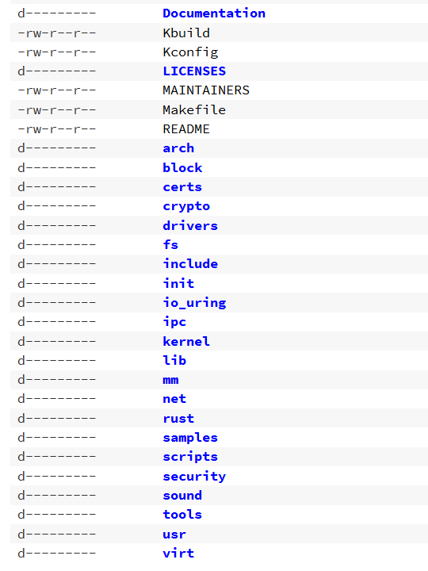
Kernel tree
https://web.git.kernel.org/pub/scm/linux/kernel/git/torvalds/linux.git/tree/

Slide 12
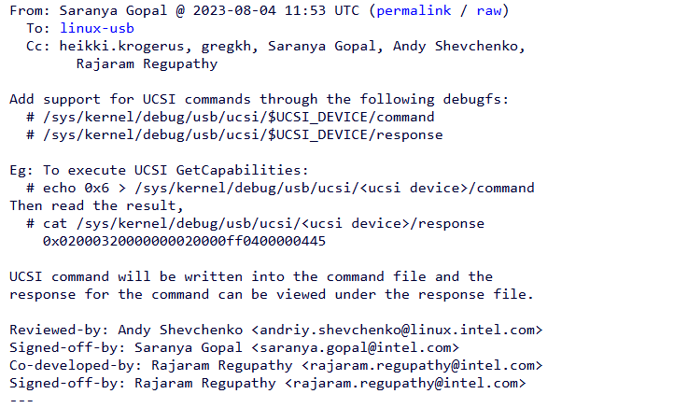
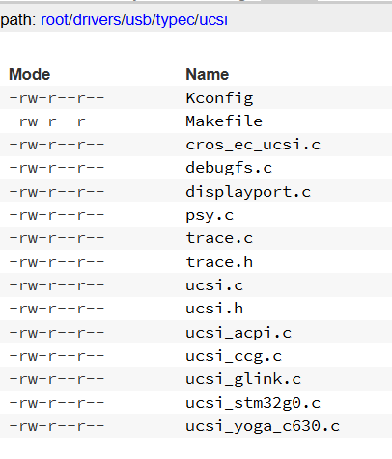
Example of a kernel patch
https://lore.kernel.org/all/2023080414-carnation-driven-ec73@gregkh/T/
Kernel patch submission guidelines: https://www.kernel.org/doc/html/v6.14/process/submitting-patches.html

Slide 13
System Calls
System calls allow user-space applications to request kernel services. Few examples below:
- `read()`, `write()` - File operations
- `fork()`, `exec()` - Process creation
- `open()`, `close()` - File handling

Slide 14
Process Management
Linux Processes:
- Created using `fork()`
- Run using `exec()`
- Scheduled based on priority
- Communicate via IPC (pipes, shared memory, message queues)
Common Commands:
- `ps` - Show running processes
- `kill` - Terminate a process
- `top` - Monitor system performance

Slide 15
File System Basics
Linux File System Hierarchy:
- `/` - Root directory
- `/home/` - User files
- `/bin/` - Executable programs
- `/etc/` - Configuration files
- `/dev/` - Device files
Permissions:
- Read (r), Write (w), Execute (x)
- Change permissions using `chmod` and `chown`

Slide 16
Introduction to Git
Git is a distributed version control system used for tracking changes in code.
- Created by Linus Torvalds in 2005
- Allows multiple developers to collaborate
- Provides history tracking, branching, and merging capabilities
Linux kernel git: https://web.git.kernel.org/pub/scm/linux/kernel/git/torvalds/linux.git

Slide 17
Install Git
Install git in Linux:
sudo apt-get install git //Debian or Ubuntu
sudo yum install git //RHEL or Fedora
Install git in windows or MacOS from https://git-scm.com/

Slide 18
Git Workflow
1. Working Directory - Local changes before tracking
2. Staging Area - Files marked for commit using `git add`
3. Local Repository - Commits stored locally using `git commit`
4. Remote Repository - Pushed to GitHub/GitLab using `git push`

Slide 19
Basic Git Commands
Essential Git Commands:
- `git init` - Initialize a repository
- `git clone <repo>` - Copy an existing repository
- `git add <file>` - Stage changes
- `git commit -m "message"` - Save changes
- `git push origin main` - Upload changes
- `git pull` - Get latest changes

Slide 20


Git Hands-on (config, init and commit)
Configure git and initialize a git project:
Create and add a file:
Modify and check status:

Slide 21
Branching and Merging
Why use branches?
- Isolate features before merging
- Allows parallel development
Common Commands:
- `git branch <branch-name>` - Create a branch
- `git checkout <branch-name>` - Switch branches
- `git merge <branch-name>` - Merge a branch
- `git rebase <branch-name>` - Reapply changes on a new base

Slide 22

Git Hands-on (working with branches)
Checkout to a new feature branch:
Add your changes:
Merge to master branch:
View the git log

Slide 23
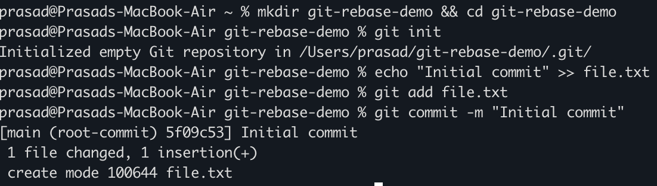
Git hands-on (rebase)
Init a new repo and commit your first change

Slide 24
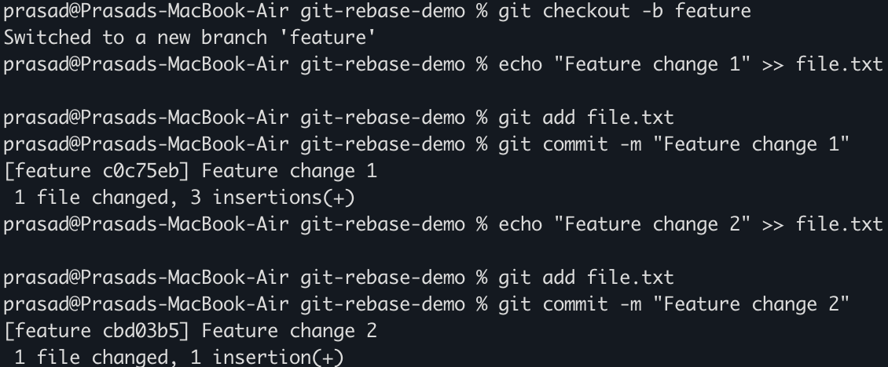
Git hands-on (rebase)
Add feature changes 1 & 2 to feature branch

Slide 25
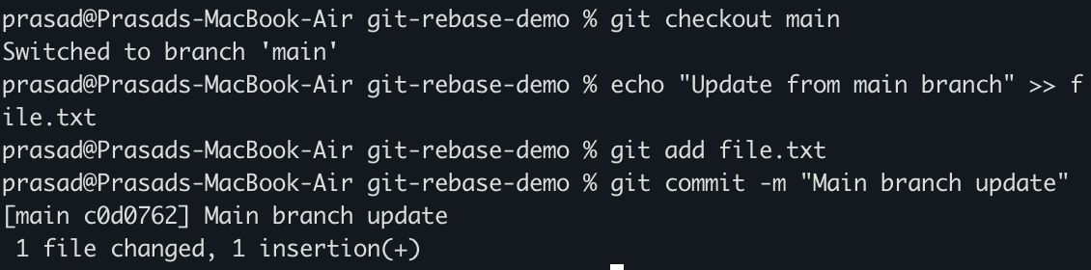
Git hands-on (rebase)
Checkout to main branch and add a new commit there

Slide 26
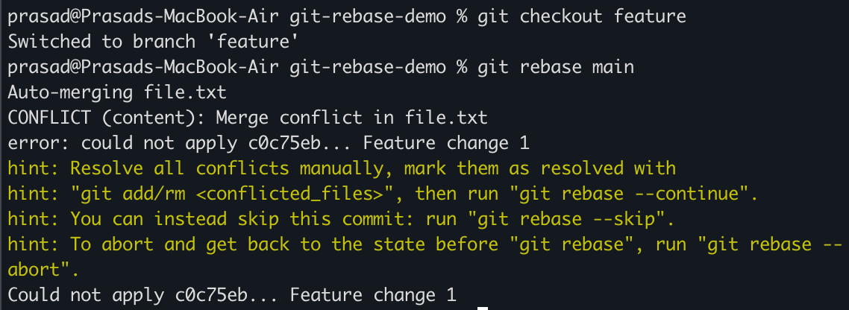
Git hands-on (rebase)
Rebase the feature branch to main. It may have conflicts!!!

Slide 27
Git hands-on (rebase)
Open the conflicting files and manually fix them
Once conflict is resolved, add the file to git
git add file.txt
Continue rebase with “git rebase –continue”
Abort the rebase any time with “git rebase –abort”

Slide 28
Git Rebase vs Merge
Merge vs Rebase:
- `git merge` - Keeps commit history, creates a merge commit
- `git rebase` - Moves commits to a new base, keeps history linear
When to use:
- Use merge for collaborative projects
- Use rebase for cleaner commit history

Slide 29
Resolving Merge Conflicts
Steps to Resolve Merge Conflicts:
1. Identify conflicts using `git status`
2. Edit the conflicting files manually
3. Use `git add <file>` to mark conflicts as resolved
4. Commit the resolution with `git commit`
Helpful Commands:
- `git diff` - View conflicts
- `git mergetool` - GUI conflict resolution

Slide 30
Git Best Practices
- Write meaningful commit messages
- Keep commits small and focused
- Use feature branches for new changes
- Regularly pull and sync with the main repository
- Avoid committing sensitive data (use `.gitignore`)

Slide 31
Conclusion & Resources
Linux and Git are essential for developers.
**Further Learning:**
- [Linux Kernel Documentation](https://www.kernel.org/doc/)
- [Pro Git Book](https://git-scm.com/book/en/v2)
- Hands-on practice with GitHub/GitLab

